Slide 1
Syntactic parsing and context-free grammars

Slide 2
Ambiguity
I saw the woman with the telescope wrapped in paper.
3

Slide 3


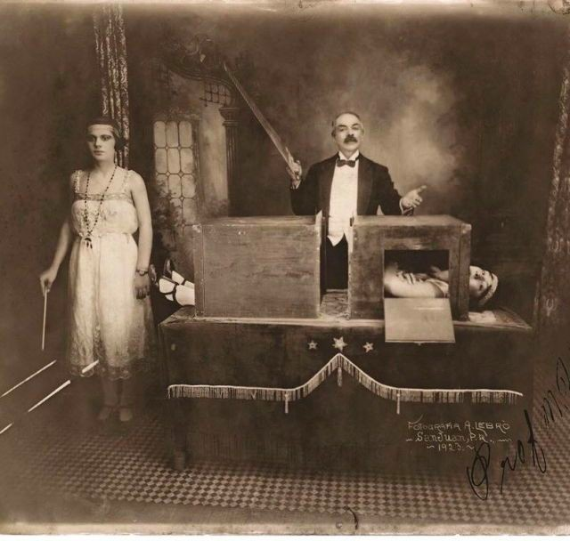
Ambiguity
I saw the woman with the telescope wrapped in paper.
■
■
■
Who has the telescope?
Who or what is wrapped in paper? Event of perception or assault?
3

Slide 4
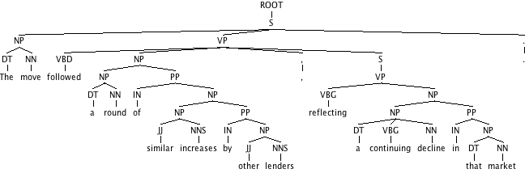
Syntactic parsing
Input:
The move followed a round of similar increases by other lenders, reflecting a continuing decline in that market.
Output:
4

Slide 5
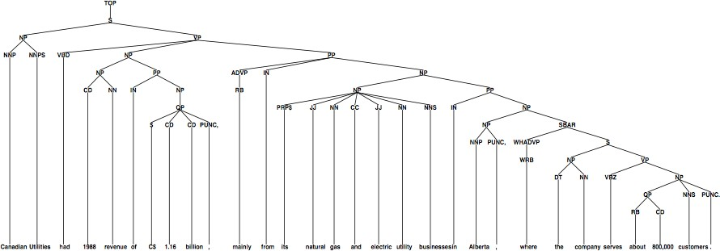
Parsing as supervised ML
Data for parsing experiments:
WSJ portion of the Penn Treebank = 50k sentences annotated with trees
Usual train/test split: 40k training, 1700 development, 2400 test
Canadian Utilities had 1988 revenue of $ 1.16 billion , mainly from its natural gas and electric utility businesses in Alberta , where the company serves about 800,000 customers .
5

Slide 6
Syntax
The study of the patterns of formation of sentences and phrases from words
my dog
the dog
the cat
and
the large cat
the black cat
ate a sausage
Pron N
Det N Det N Conj
Det Adj N Det Adj N V Det N
6

Slide 7
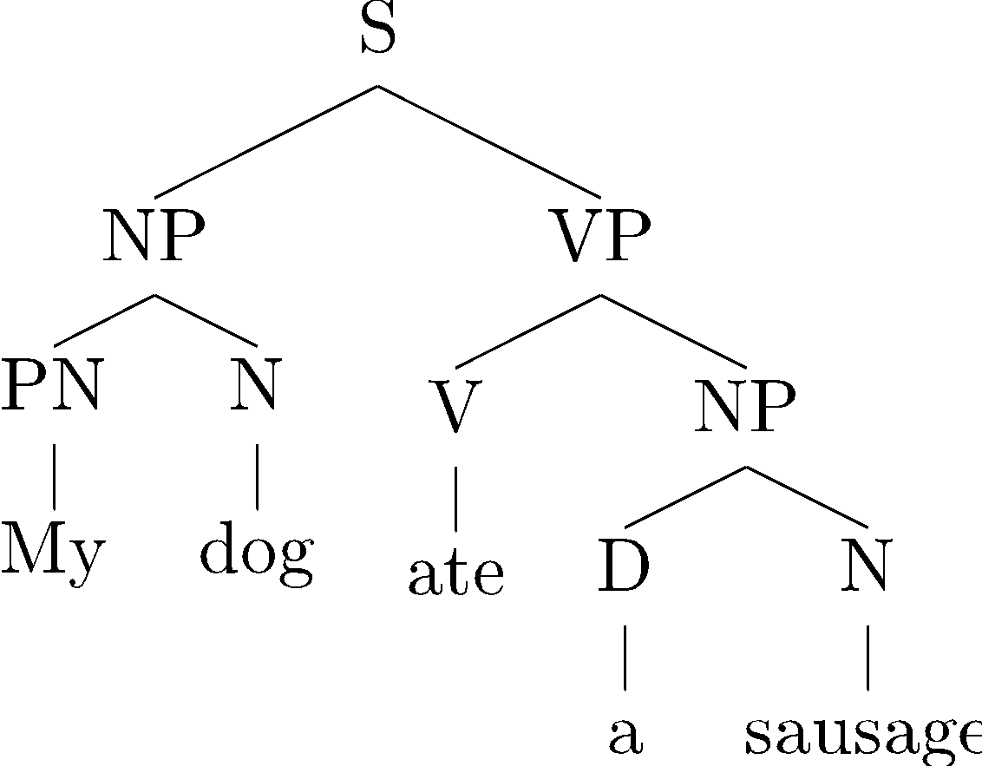
Parsing
The process of predicting syntactic representations
Different types of syntactic representations are possible, for example:
constituency (aka phrase-structure) tree
7

Slide 8
Constituency trees
Internal nodes correspond to phrases.
S: a sentence
NP (noun phrase): My dog, a sandwich, lakes, …
VP (verb phrase): ate a sausage, barked, …
PP (prepositional phrases): with a friend, in a car, …
Nodes immediately above words are part-of-speech tags (or preterminals).
PN: pronoun D:determiner V: verb
N: noun
P: preposition
8

Slide 9
Bracketing notation
Often convenient to represent a tree as a bracketed sequence:
(S
(NP (PN My) (N dog) )
(VP (V ate)
(NP (D a) (N sausage) )
)
)
9

Slide 10
Parsing
The process of predicting syntactic representations
Different types of syntactic representations are possible, for example:
root
dobj
poss
nsubj
det
root
My
PN
dog
N
ate
V
a sausage
D N
constituency (aka phrase-structure) tree
dependency tree
10

Slide 11
Dependency trees
root
dobj
poss
nsubj
det
root
My
PN
dog
N
ate
V
a sausage
D N
Nodes are words (along with part-of-speech tags)
Directed arcs encode syntactic dependencies between words
Labels are types of relations between words
poss: possessive
dobj: direct object
nsubj: (noun) subject
det: determiner
11

Slide 12
Dependency parsing
root
dobj
Recovering shallow semantics
root
poss
nsubj
det
My
PN
dog
N
ate
V
a sausage
D N
Some semantic information can be (approximately) derived from syntactic information
Subjects (nsubj) are (often) agents: initiators / doers of an action
Direct objects (dobj) are (often) patients: affected entities
Even for agents and patients, consider:
Mary is baking a cake in the oven
A cake is baking in the oven
In general, it is not trivial even for the most shallow forms of semantics
e.g. prepositions: in can encode direction, position, temporal information, …

Slide 13
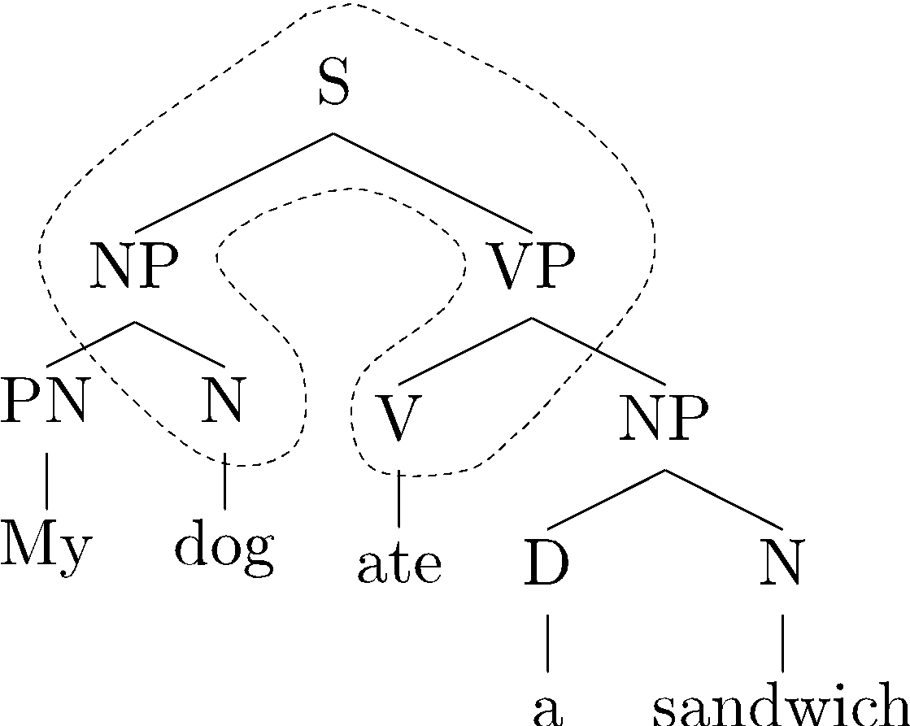
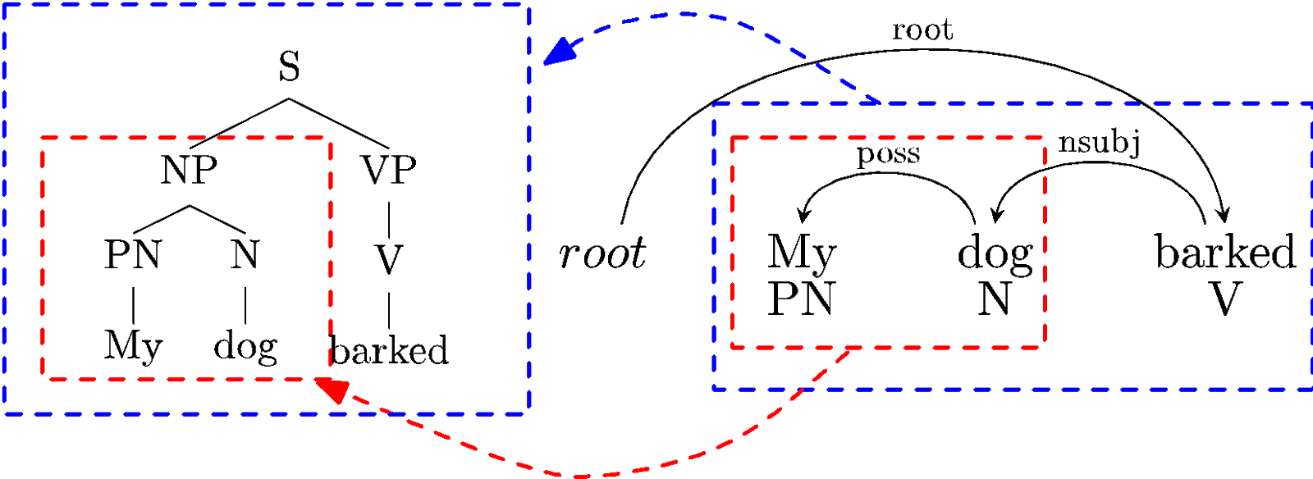
Constituency and dependency representations
Constituency trees can (potentially) be converted to dependency trees.
Dependency trees can (potentially) be converted to constituency trees.
13

Slide 14
Constituency trees
Internal nodes correspond to phrases.
S: a sentence
NP (noun phrase): My dog, a sandwich, lakes, …
VP (verb phrase): ate a sausage, barked, …
PP (prepositional phrases): with a friend, in a car, …
Nodes immediately above words are part-of-speech tags (or preterminals).
PN: pronoun
D: determiner
V: verb
N: noun
P: preposition

Slide 15
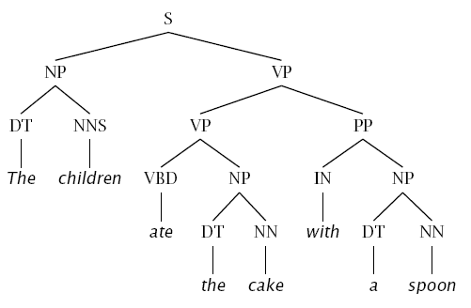
Constituency tests
How do we know what nodes go in the tree?
Classic constituency tests:
Replacement
Substitution by proform
Movement: Clefting, preposing, passive Modification
Coordination / conjunction
Ellipsis / deletion
15

Slide 16
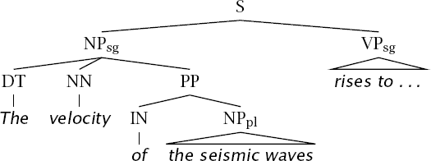
Conflicting tests
Constituency is not always clear.
Coordination:
He went to and came from the store.
Phonological reduction : I will go → I’ll go
I want to go → I wanna go
a le centre → au centre
La velocité des ondes sismiques
16

Slide 17
Morphology + syntax + semantics
Syntax: The study of the patterns of formation of sentences and phrases from a word.
Borders with semantics and morphology are sometimes blurred.
17

Slide 18
Context-free grammars (CFGs)
Context-free grammars (CFGs): a formalism for parsing.
Grammar (CFG)
Lexicon
NN → interest NNS → raises VBP → interest VBP → raises
…
ROOT → S
S → NP VP NP → DT NN NP → NN NNS
NP → NP PP
VP → VBP NP
VP → VBP NP PP PP → IN NP
Other grammar formalisms: LFG, HPSG, TAG, CCG, …
18

Slide 19
Context-free grammars (CFGs)
Grammar (CFG)
S → NP VP
Lexicon
N → girl
N → telescope N → sandwich PN → I
V → saw V → ate P → with P → in
D → a D → the
VP → V
VP → V NP VP → VP PP
NP → NP PP NP → D N NP → PN
PP → P NP

Slide 20
Context-free grammars (CFGs)
Lexicon
N → girl
N → telescope N → sandwich PN → I
V → saw V → ate P → with P → in
D → a D → the
Grammar (CFG)
S → NP VP
VP → V
VP → V NP VP → VP PP
NP → NP PP NP → D N NP → PN
PP → P NP
20

Slide 21
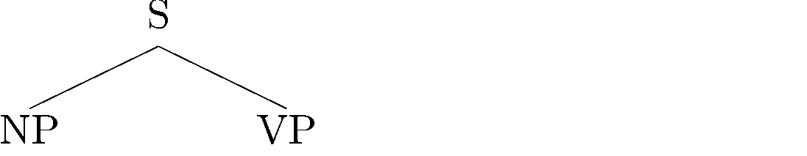
Context-free grammars (CFGs)
Lexicon
N → girl
N → telescope N → sandwich PN → I
V → saw V → ate P → with P → in
D → a D → the
Grammar (CFG)
S → NP VP
VP → V
VP → V NP VP → VP PP
NP → NP PP NP → D N NP → PN
PP → P NP
21

Slide 22
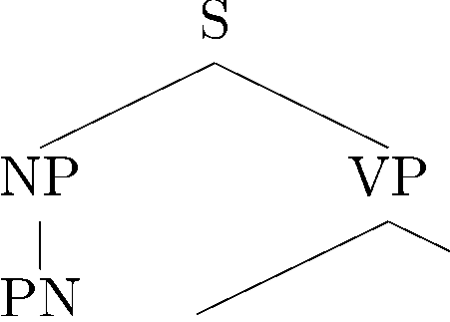
Context-free grammars (CFGs)
Grammar (CFG)
S → NP VP
Lexicon
N → girl
N → telescope N → sandwich PN → I
V → saw V → ate P → with P → in
D → a D → the
VP → V
VP → V NP VP → VP PP
NP → NP PP NP → D N
NP → PN
PP → P NP
22

Slide 23
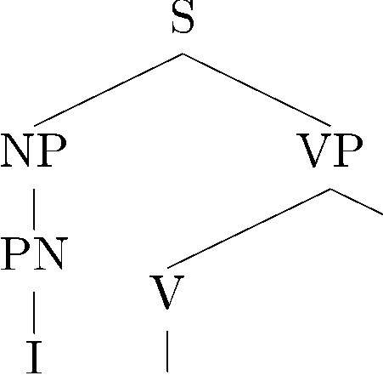
Context-free grammars (CFGs)
Grammar (CFG)
S → NP VP
Lexicon
N → girl
N → telescope N → sandwich
VP → V
VP → V NP VP → VP PP
PN → I
V → saw V → ate P → with P → in
D → a D → the
NP → NP PP NP → D N NP → PN
PP → P NP
23

Slide 24
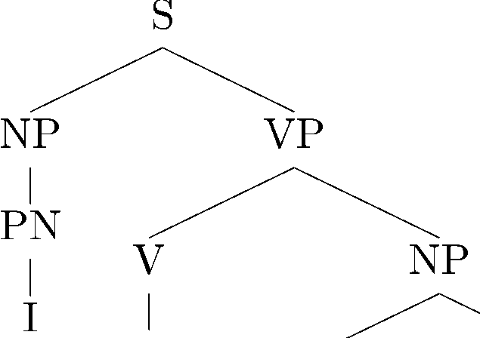
Context-free grammars (CFGs)
Grammar (CFG)
S → NP VP
Lexicon
N → girl
N → telescope N → sandwich PN → I
V → saw V → ate P → with P → in
D → a D → the
VP → V
VP → V NP
VP → VP PP
NP → NP PP NP → D N NP → PN
PP → P NP
24

Slide 25
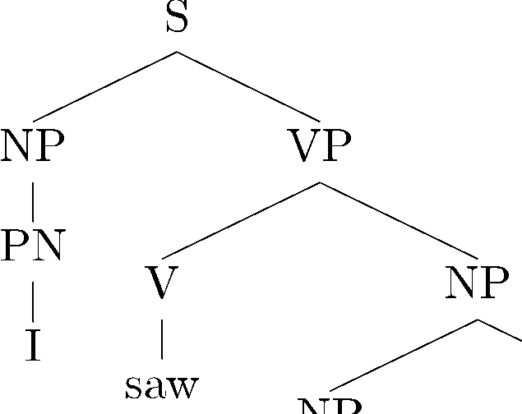
Context-free grammars (CFGs)
Grammar (CFG)
S → NP VP
Lexicon
N → girl
N → telescope N → sandwich PN → I
VP → V
VP → V NP VP → VP PP
V → saw
V → ate P → with P → in
D → a D → the
NP → NP PP NP → D N NP → PN
PP → P NP
25

Slide 26
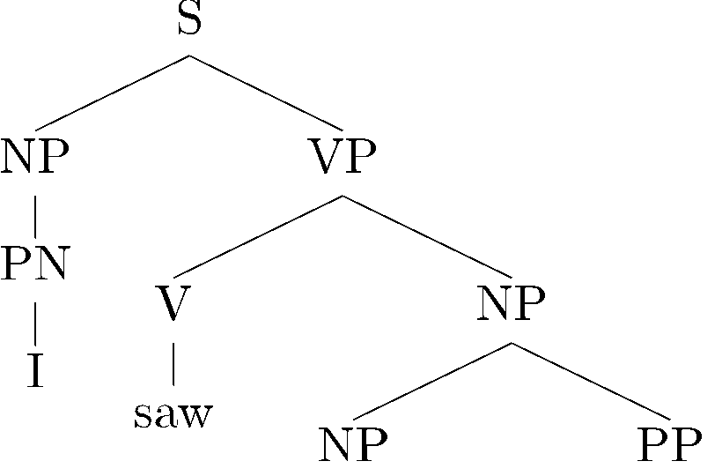
Context-free grammars (CFGs)
Grammar (CFG)
S → NP VP
Lexicon
N → girl
N → telescope N → sandwich PN → I
V → saw V → ate P → with P → in
D → a D → the
VP → V
VP → V NP VP → VP PP
NP → NP PP
NP → D N NP → PN
PP → P NP
26

Slide 27
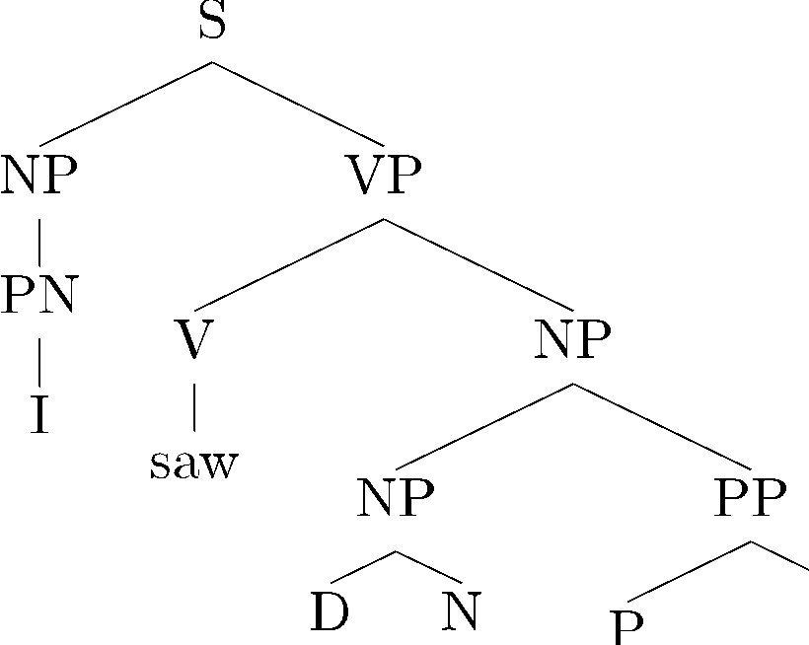
Context-free grammars (CFGs)
Grammar (CFG)
S → NP VP
Lexicon
N → girl
N → telescope N → sandwich PN → I
V → saw V → ate P → with P → in
D → a D → the
VP → V
VP → V NP VP → VP PP
NP → NP PP
NP → D N
NP → PN
PP → P NP

Slide 28
Context-free grammars (CFGs)
Grammar (CFG)
S → NP VP
Lexicon
N → girl
N → telescope N → sandwich PN → I
V → saw V → ate P → with P → in
D → a D → the
VP → V
VP → V NP VP → VP PP
NP → NP PP
NP → D N
NP → PN
PP → P NP
28

Slide 29
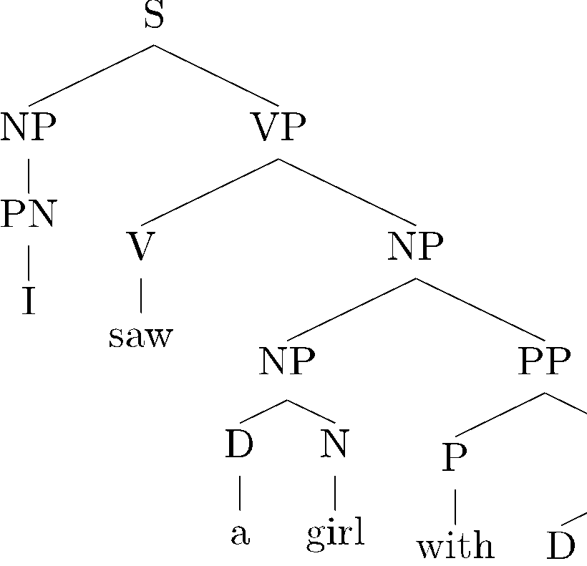
Context-free grammars (CFGs)
Grammar (CFG)
S → NP VP
Lexicon
N → girl
N → telescope N → sandwich PN → I
V → saw V → ate P → with P → in
VP → V
VP → V NP VP → VP PP
NP → NP PP NP → D N NP → PN
D → a
D → the
PP → P NP
29

Slide 30
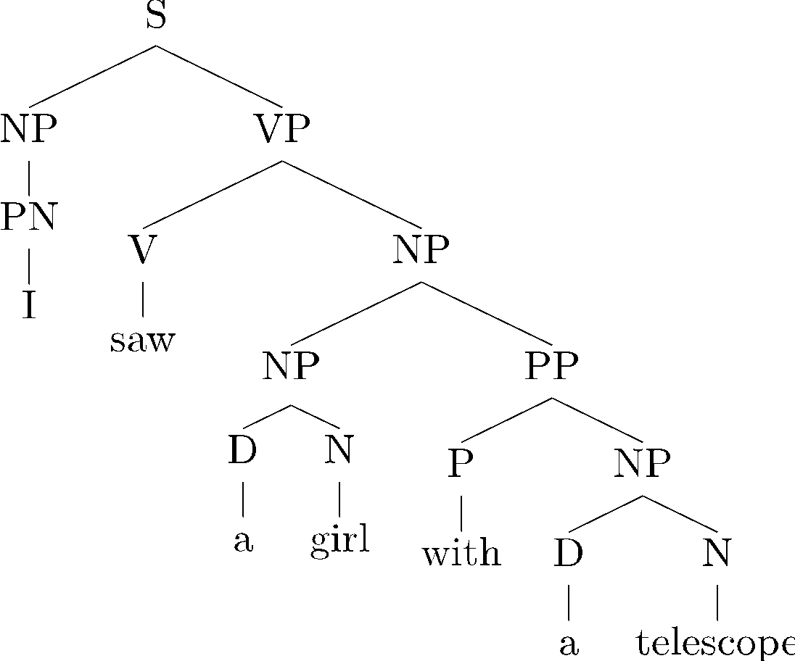
Context-free grammars (CFGs)
Grammar (CFG)
S → NP VP
Lexicon
N → girl
N → telescope N → sandwich PN → I
V → saw V → ate P → with P → in
D → a D → the
VP → V
VP → V NP VP → VP PP
NP → NP PP NP → D N NP → PN
PP → P NP
30

Slide 31
Context-free grammars (CFGs)
CFG: Formal definition. A 4-tuple (N, Σ, R, S):
N a set of non-terminal symbols (or variables)
Σ a set of terminal symbols (disjoint from N)
a set of rules or productions, each of the form A →δ, where
A is a non-terminal,
δ is a string of symbols from the infinite set of strings (ΣŲ N)*
S a designated start symbol and a member of N
31

Slide 32
Context-free grammars (CFGs)
CFG: Formal definition. A 4-tuple (N, Σ, R, S):
VP, NP, S, PP, … V, N, P…
saw, telescope, the, girl, …
N a set of non-terminal symbols (or variables)
S a set of terminal symbols (disjoint from N)
R a set of rules or productions, each of the form A ! b ,
where A is a non-terminal,
NP → NP PP, …
b is a string of symbols from the infinite set of strings (S [ N)⇤
S a designated start symbol and a member of N
ROOT, TOP
31

Slide 33
An example grammar
N = {S, VP, NP, PP, N, V, PN, P}
Σ = {girl, telescope, sandwich, I, saw, ate, with, in, a, the}
preterminal rules N → girl
N → telescope N → sandwich PN → I
V → saw V → ate P → with P → in
D → a
D → the
S = {S}
R =
S → NP VP (NP a girl) (VP ate a sandwich)
VP → V
VP → V NP VP → VP PP
inner rules
(V ate) (NP a sandwich)
(VP saw a girl) (PP with a telescope)
NP → NP PP NP → D N NP → PN
(NP a girl) (PP with a sandwich) (D a) (N sandwich)
PP → P NP
(P with) (NP a sandwich)
32

Slide 34
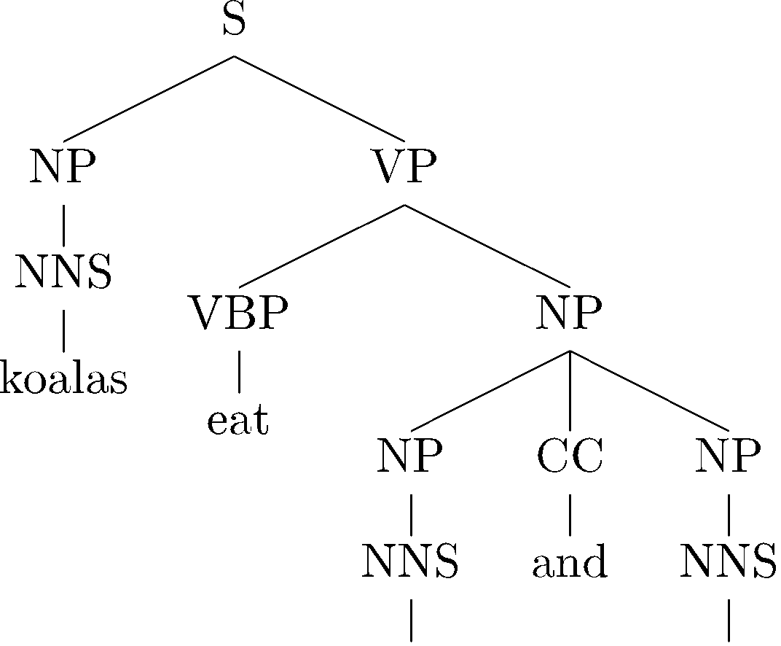
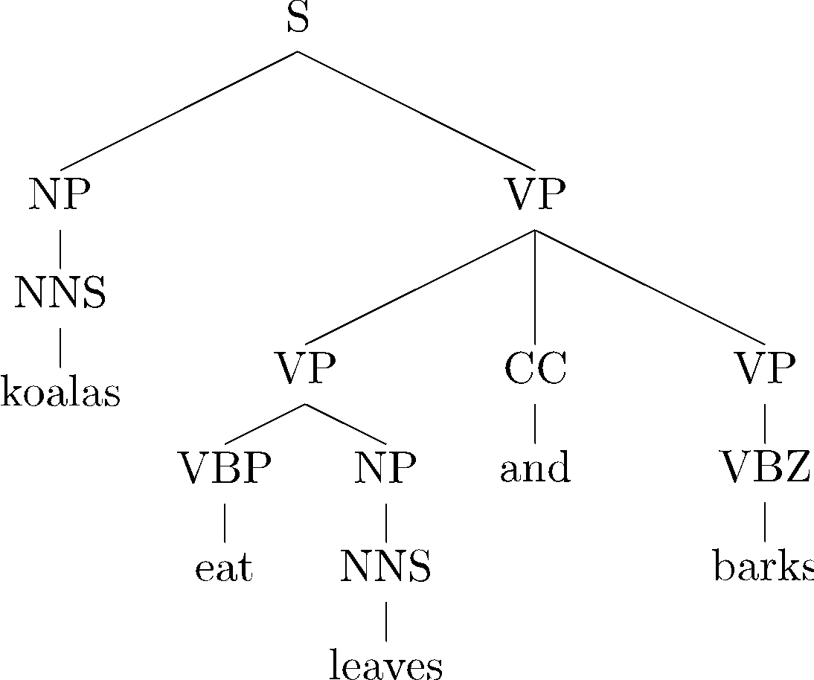


Ambiguity
Ambiguity makes parsing hard.
Example: coordination ambiguity
For example: coarse VP and NP categories can’t enforce subject-verb agreement in number, resulting in this coordination ambiguity.
coordination
this tree would be ruled out if the context could be captured (subject-verb agreement)
bark may be a noun or a verb
34

Slide 35
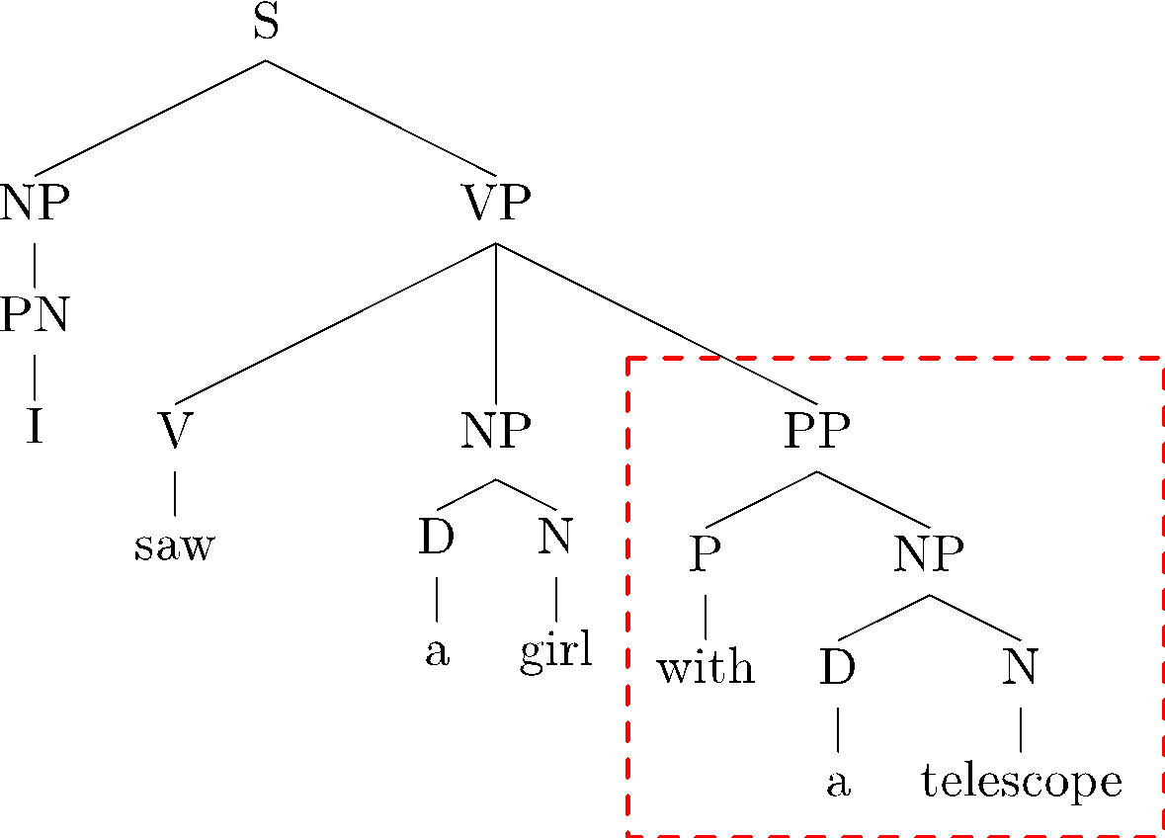
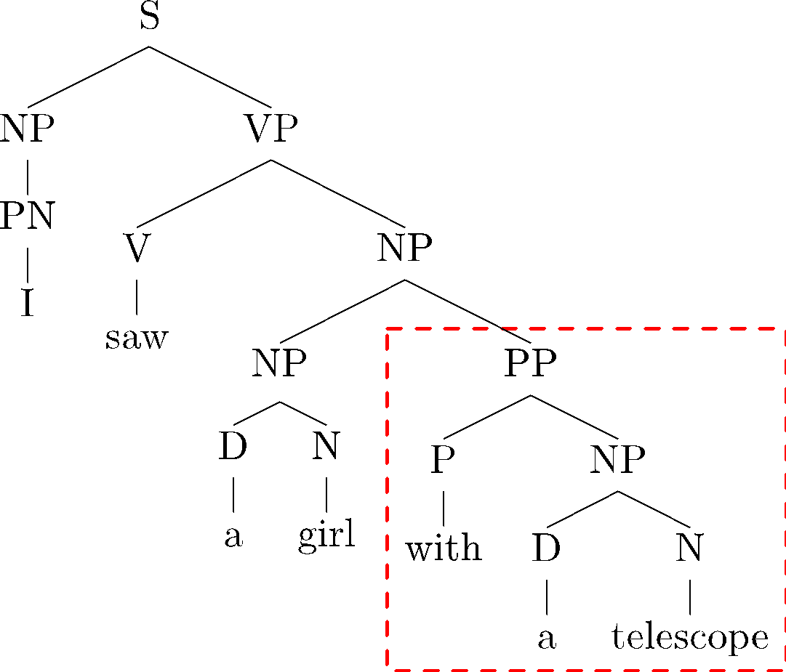
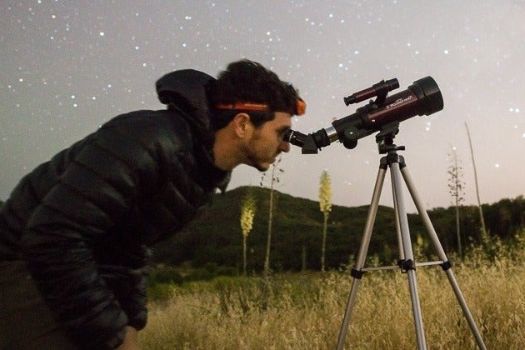
Ambiguity
Ambiguity makes parsing hard.
Example: prepositional phrase attachment ambiguity
35

Slide 36
Ambiguity
Ambiguity makes parsing hard.
Example: prepositional phrase attachment ambiguity
35

Slide 37
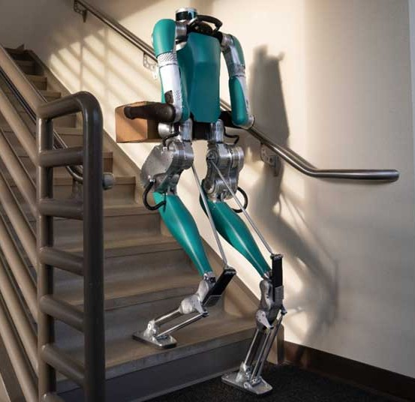
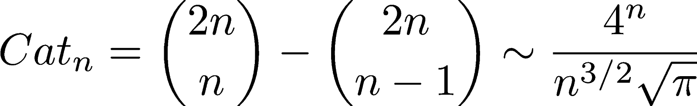
Prepositional phrase ambiguity
“Put the block in the box on the table in the kitchen.”
3 prepositional phrases, 5 interpretations:
Put the block ((in the box on the table) in the kitchen.)
Put the block (in the box (on the table in the kitchen.)
Put ((the block in the box) on the table) in the kitchen.
Put (the block (in the box on the table)) in the kitchen.
Put (the block in the box) (on the table in the kitchen.)
General case:
((())) ()(()) ()()() (())() (()())
Catalan numbers:
36

Slide 38
Typical tree
Canadian Utilities had 1988 revenue of $ 1.16 billion , mainly from its natural gas and electric utility businesses in Alberta , where the company serves about 800,000 customers .

Slide 39
More syntactic ambiguities
Prepositional phrases:
They cooked the beans in the pot on the stove with handles.
Particle vs. preposition:
The puppy tore up the staircase
Complement structures:
The tourists objected to the guide that they couldn’t hear. She knows you like the back of her hand.
Gerund vs. participal adjective:
Visiting relatives can be boring.
Changing schedules frequently confused passengers.
38

Slide 40
More syntactic ambiguities
Modifier scope within NPs: impractical design requirements plastic cup holder
Multiple gap constructions:
The chicken is ready to eat.
The contractors are rich enough to sue.
Coordination scope:
Small rats and mice and squeeze into holes or cracks in the wall.
39

Slide 41
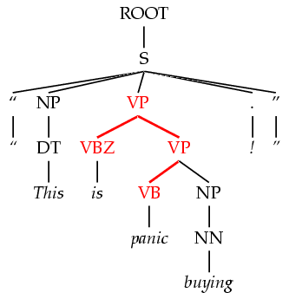
Dark ambiguities
Dark ambiguities: most analyses are shockingly bad (meaning, they don’t have an interpretation you can get your mind around.)
This analysis corresponds to the correct parse of:
“This is panic buying!”
Unknown words and new usages
Solution: need mechanisms to focus attention on the best ones… probabilistic techniques do this.
40

Slide 42
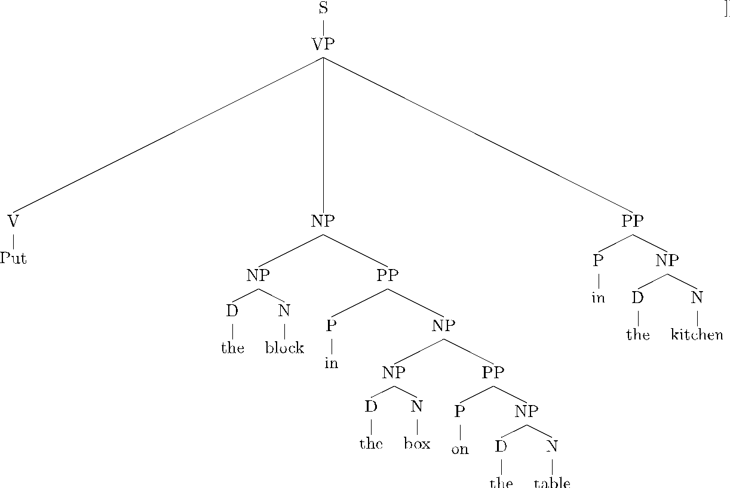
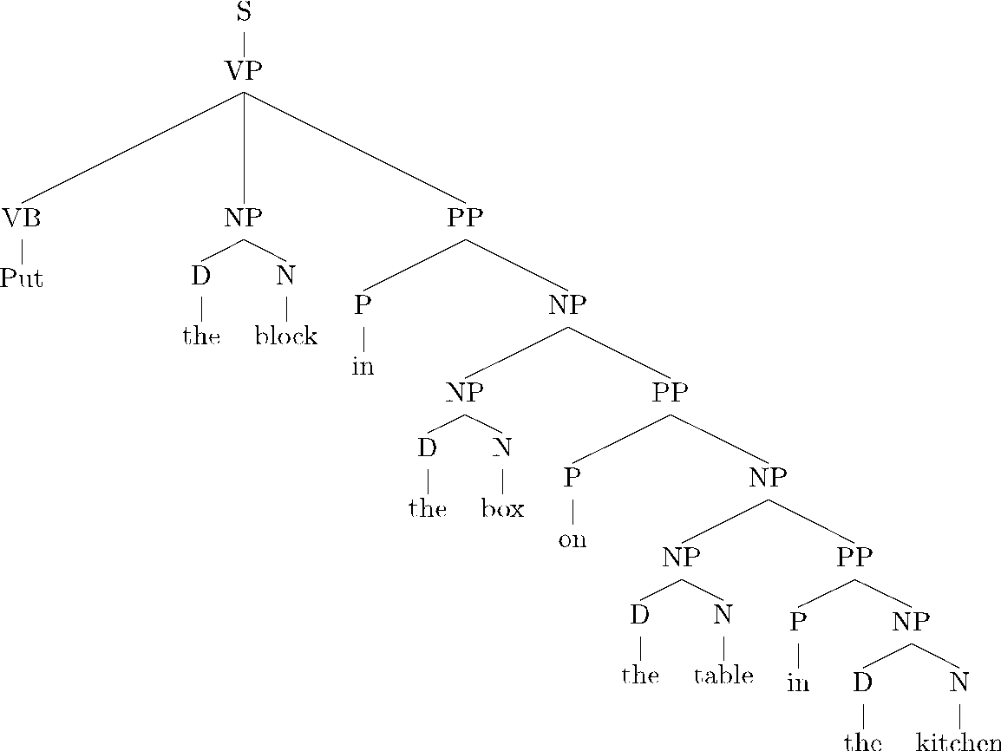
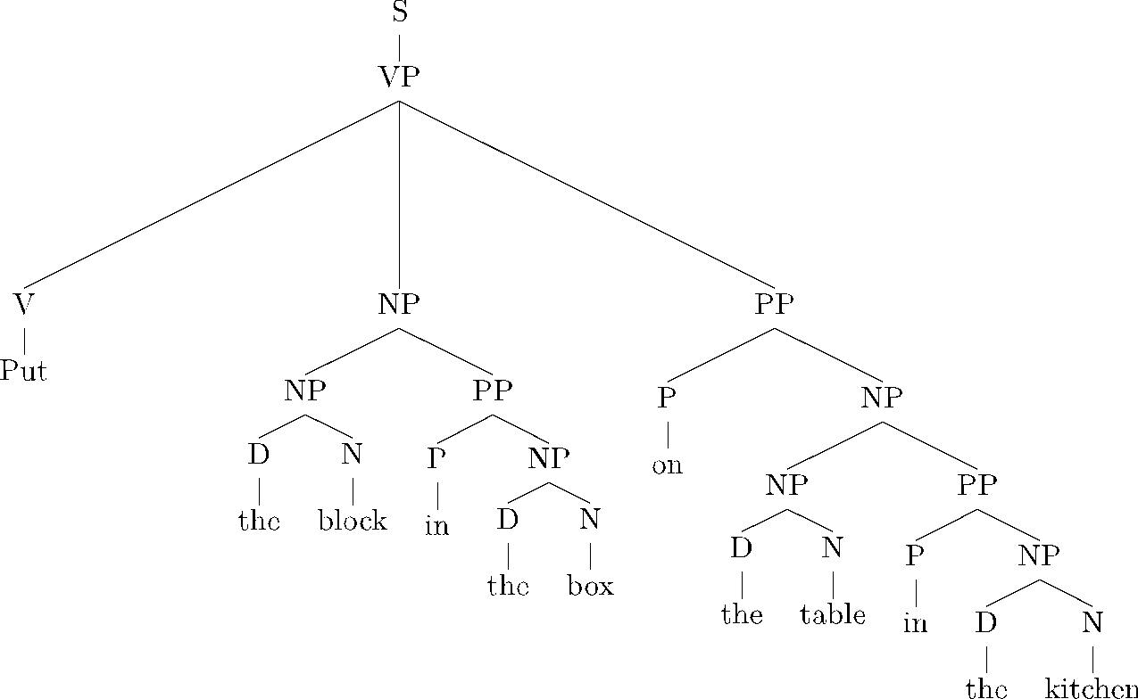
How to deal with ambiguity?
Put the block in the box on the table in the kitchen.
Want to score all derivations to encode how plausible they are.
41

Slide 43
Probabilistic context-free grammars (PCFGs)
CFG: A 4-tuple (N, Σ, R, S):
N a set of non-terminal symbols (or variables)
S a set of terminal symbols (disjoint from N)
A →δ, where
A is a non-terminal,
δ is a string of symbols from the infinite set of strings (ΣŲ N)*
S a designated start symbol and a member of N
A PCFG adds: a top-down production probability per rule.
If each rule is of the form X → Y1Y2…Yk
Model its probability: P(Y1Y2…Yk | X)
42

Slide 44
An example PCFG
Associate probabilities with the rules:
S → NP VP | 1.0 | (NP a girl) (VP ate a sandwich)
VP → V | 0.2
VP → V NP | 0.4 | (V ate) (NP a sandwich)
VP → VP PP | 0.4 | (VP saw a girl) (PP with a
NP → NP PP | 0.3 | (NP a girl) (PP with a sandwich)
NP → D N | 0.5 | (D a) (N sandwich)
N → girl | 0.2
N → telescope | 0.7
N → sandwich | 0.1
PN → I | 1.0
V → saw | 0.5
V → ate | 0.5
P → with | 0.6
Now we can score a tree as a product of probabilities corresponding to
the used rules!
P → in
D → a
D → the
0.4
0.3
0.7
NP → PN
0.2
PP → P NP
1.0
(P with) (NP a sandwich)
43

Slide 45
Context-free grammars (CFGs)
1.0
S → NP VP | 1.0
VP → V | 0.2
VP → V NP | 0.4
VP → VP PP | 0.4
NP → NP PP | 0.3
NP → D N | 0.5
NP → PN | 0.2
PP → P NP | 1.0
N → girl | 0.2
N → telescope | 0.7
N → sandwich | 0.1
PN → I | 1.0
V → saw | 0.5
V → ate | 0.5
P → with | 0.6
P → in | 0.4
D → a | 0.3
D → the | 0.7
0.2
0.4
1.0
0.3
0.5
0.5
1.0
0.3 0.2
0.6
0.5
0.3
0.7
P(T) = 1.0 * 0.2 * 1.0 * 0.4 * 0.5 * 0.3 * 0.5 * 0.3 * 0.2 * 1.0 * 0.6 * 0.5 * 0.3 * 0.7 = 2.26e-5

Slide 46
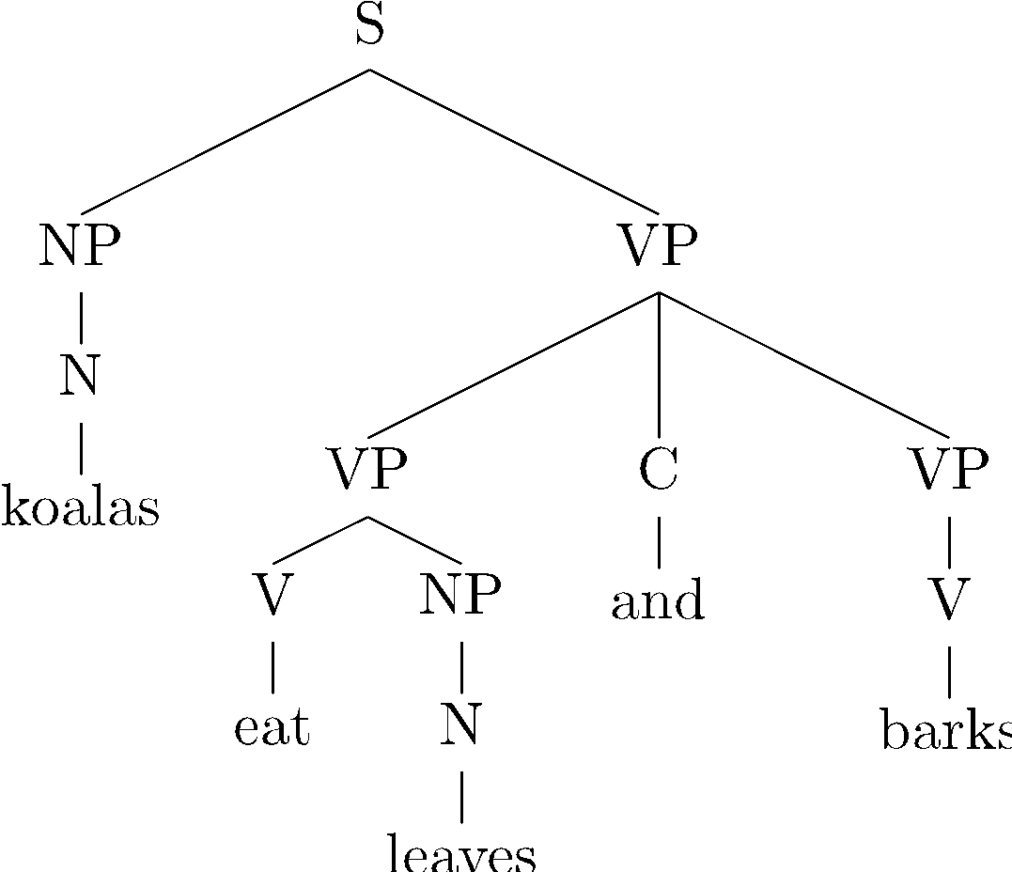
PCFG estimation
A treebank: a collection of sentences annotated with constituency trees
…
Estimated probability of a rule (maximum likelihood estimate):
Smoothing is helpful (especially for preterminal rules).
53

Slide 47
Distribution over trees
We defined a distribution over production rules for each nonterminal.
Our goal was to define a distribution over parse trees.
Unfortunately, not all PCFGs result in a proper distribution over trees, i.e. the sum over probabilities of all trees in the grammar may be less than 1.
Fortunately: any PCFG estimated by maximum likelihood is always proper [Chi and Geman, 1998].
54

